Slide 1
Facebook Online Anytime Book Club
Sara Kumerow Digital Services Librarian
Oshkosh Public Library
kumerow@oshkoshpubliclibrary.org

Slide 2
What is the online anytime book club?
Monthly Facebook live broadcast from the Oshkosh Public Library’s Facebook page
Usually a short broadcast (10 to 15 minutes long)
Each month focuses on a specific “theme” and discusses books based around that theme
Viewers can tune in & comment on the live broadcast, or watch and comment on the replay posted on our Facebook page

Slide 3
The first Online Anytime Book Club!

Slide 4
Why a facebook live book club?
Biggest motivation: patron demand for “low-commitment” book club
No time commitment (don’t have to come to the library to participate)
Flexible reading (don’t all have to read the same book)
Offering a book club online = way to potentially address these needs

Slide 5
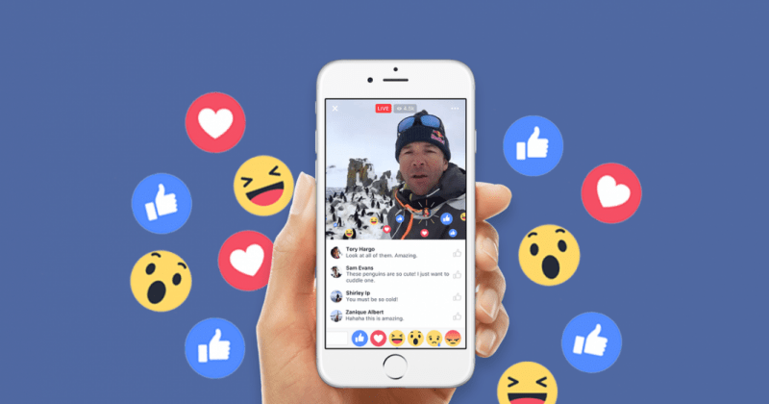
Facebook is a good tool for doing online programming
Widely used by patrons
Library already has an active presence on Facebook
Variety of different tools that can be utilized for book club (groups, live video, etc)
Live video combines “best of both worlds”
Patrons can “tune in” at set time & participate, or watch and comment on their own schedule
Can also “grab” new viewers/participants when the live stream happens
Can participate from anywhere—not just limited to people living in Oshkosh

Slide 6
THINGS CONSIDERED WHEN MAKING BOOK CLUB
When/how often should the live video happen?
Once a month
First Tuesday of the month
Picked 7 PM as the best time (after people eat dinner/get done doing family things, have time to casually surf the web)
How to get people to participate in the book club?
Promoted on Facebook (create an “event” to inform people about the live, see how many people might participate; post reminder on book club day)
Offered summer reading participation incentive
What to talk about during book club?

Slide 7
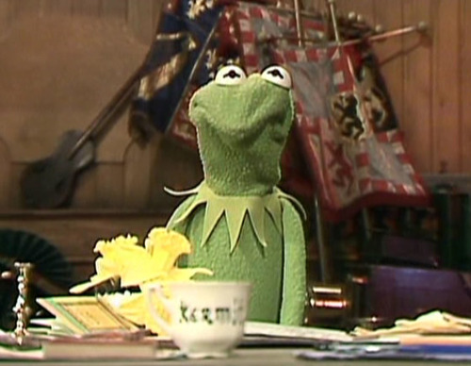
LESSONS LEARNED FROM FIRST LIVE
IT’S OKAY
Ask questions to get the conversation started
People might not be comfortable at first/not know what to expect
Be prepared to fill dead space
If you’re talking about books around a specific theme, have some of your personal recommendations ready (having physical copies to show is helpful!)
Write down some talking points/interesting details about recommendations
If you have guides or reading lists, have links ready ahead of time
Practice ahead of time
Make sure your microphone and camera are set up properly!
TO BE AWKWARD

Slide 8
SOME ONLINE BOOK CLUB STATISTICS
Facebook tracks a few different statistics for videos, including 3 second views, 10 second views, average view time, and total minutes viewed
 | 1st Live | 2nd Live | 3rd Live | 4th Live
TOTAL VIEWS (at least 3 seconds) | 738 | 420 | 460 | 373
10 SECOND VIEWS | 280 | 145 | 153 | 101
AVERAGE VIEW TIME | 0:16 | 0:13 | 0:14 | 0:13
TOTAL MIN. VIEWED | 348 | 165 | 222 | 189
UNIQUE VIEWERS | 661 | 400 | 415 | 350
PEOPLE REACHED | 1,398 | 883 | 1,290 | 1,026
On average, about 6 to 8 people actually watched during the broadcast
About 50% of the time people watched the videos with SOUND OFF

Slide 9
So you want to start your own live

Slide 10
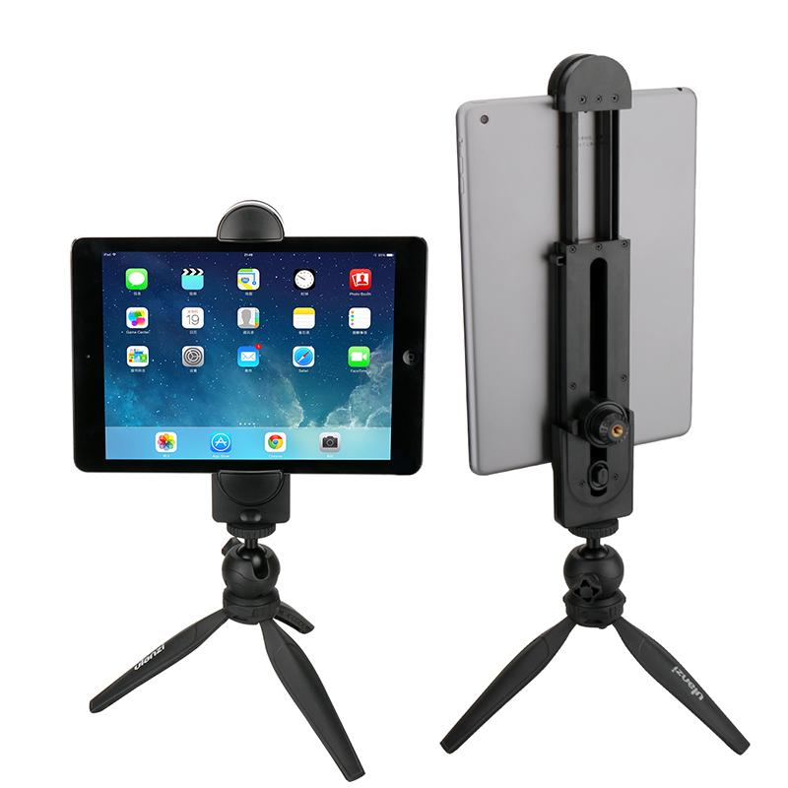
TOOLS YOU’LL NEED
Device with a camera & microphone that can be connected to the internet (EX: laptop, tablet, smartphone)
Something to prop up device if you’re using a smartphone or tablet (and staying in one place)
Facebook app (or just a Facebook account if you’re using a laptop)
Books/props/things to make the video more interesting
***(Also nice to have another person with you to answer questions in the chat, but not a necessity)***

Slide 11
Getting Started with Facebook Live
Open and login to Facebook
Go to your library’s Facebook page, and start writing a status update
Click on the Live Video button underneath the status box (looks like or )
Click Continue; give your device permission to access your camera and microphone
Add a description for your live & choose your privacy level (will the live be visible to the public, to just your friends, or only to you?)
Make sure your camera is set up the way you want
Click Go Live!

Slide 12
Now Let’s Go live!!!

Slide 13
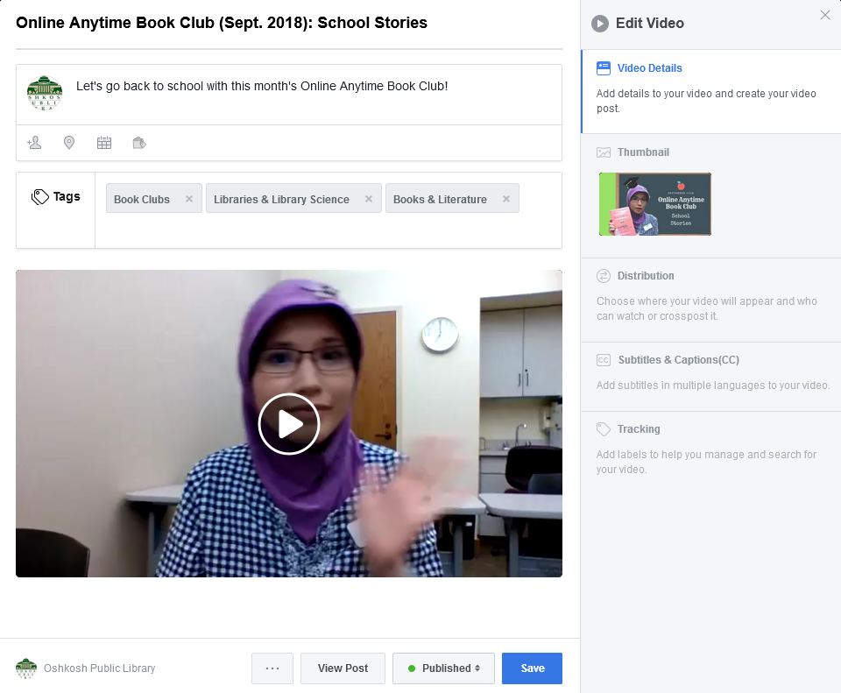
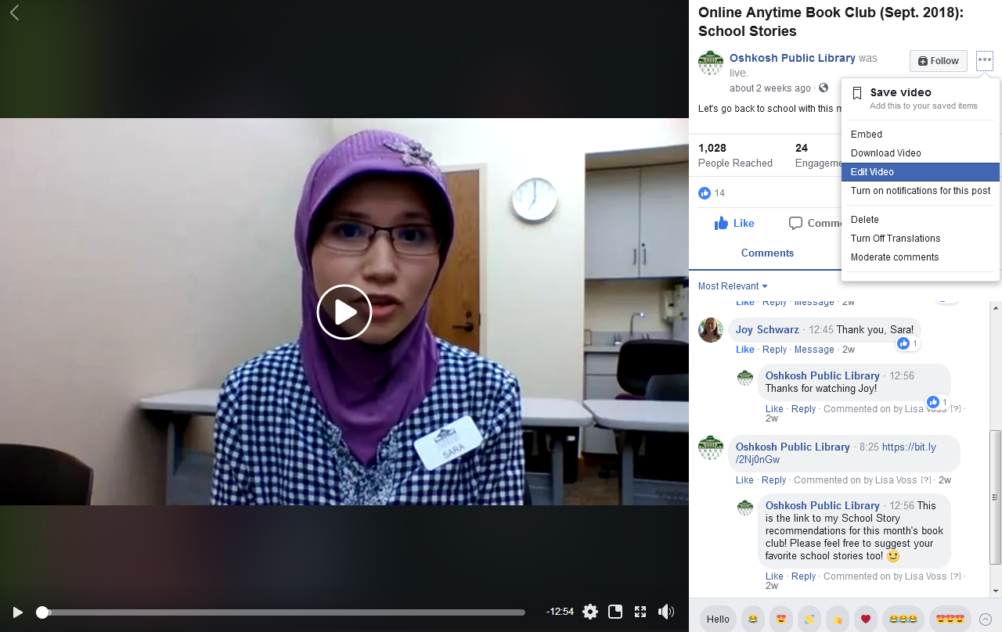
Once your broadcast has ended, you can edit it to help attract more viewers
Most people will be watching the replay of your live, so this is important!
Give your video a fun description
Open your video in your Facebook account, then click the three dots to get to the “Edit Video” menu
Give your video an eye-catching thumbnail
Add tags to help your video reach a bigger audience
Add captions

Slide 14
MORE FACEBOOK LIVE IDEAS FOR LIBRARIES
“Guest appearances”
More “focused” videos
Increasing accessibility
Promoting other library programs
Reading challenges
Get inspiration from “BookTube”

Slide 15
Questions?

